Slide 1
Classroom Dynamics: How to Better Support Underrepresented Students by Better Understanding “Microaggressions.”
College of the Redwoods

Slide 3
What stood out for you in this video clip?

Slide 4
Microaggressions are:
Outside of our conscious awareness.
Most damaging when they are hidden & non-intentional forms of bias.
Constant, continual and cumulative.
Are hard to prove and quantify.
Often come from well-intentioned people.

Slide 5
What are “microaggressions”?
Microaggressions are subtle, offensive comments or actions directed at an underrepresented group that is often unintentional or unconsciously reinforces a stereotype.

Slide 6
Examples of possible microaggressions:
“What country are you from?”
“You don’t talk like a Black person.”
“You speak English so well—without an accent.”
“Did you steal my item?”
“Your husband is so lucky.”
“Honey.”
“I’ll call you what I feel comfortable calling you.”
“My best friends are…”
“It’s just a joke.”

Slide 7
Examples of microaggressions:
Not acknowledging someone.
Not including some in the conversation based on race.
Speaking over someone.

Slide 8
“I don’t have hidden biases. I certainly don’t allow biases to interfere with my teaching. If I did, that would make me a bad person and a bad instructor.”

Slide 9
Unconscious bias
The brain develops associations and these become part of our wiring.
We can learn to control it.

Slide 10
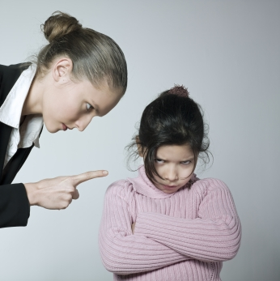
Microaggressions and unconscious bias cause more harm when committed by those who have power.

Slide 11
What if microaggressions come from people who hold institutional power?

Slide 12
Some tools to control and diminish microaggressions:
Be mindful of it.
Listen to students’ experience and learn.
Apologize when necessary.
Don’t tolerate it from others.
Practice “Welcoming Engagement” with students: Form relationships with underrepresented students outside the classroom. Show them you authentically care about them.

