Slide 1
Media Preferences Survey Results
College of the Redwoods
February 2016

Slide 2
429 CR students participated in the survey via e-mail in fall 2015.
One student was randomly selected to win an Amazon gift card.
The Interact marketing consulting firm conducted the survey.
Here are the results from a selected set of questions.

Slide 3
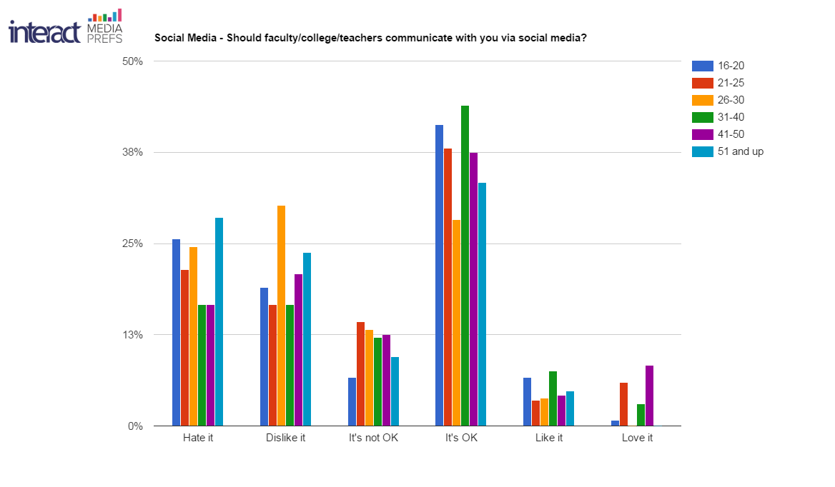

Slide 4
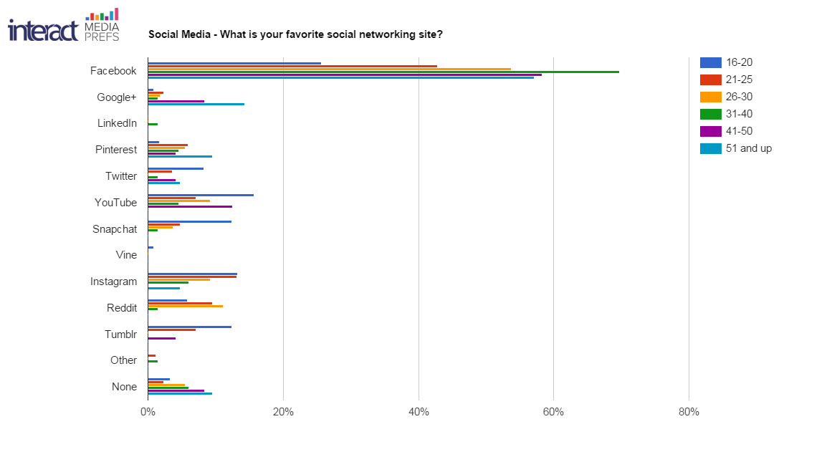

Slide 5
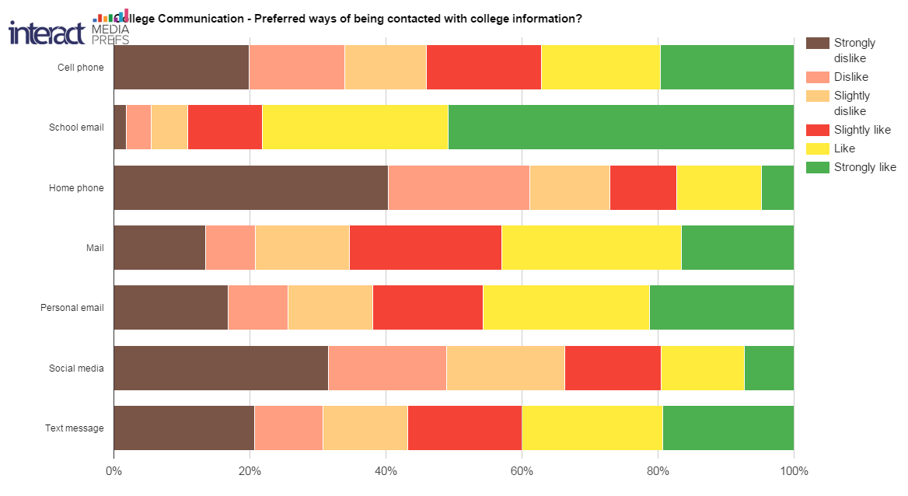

Slide 6
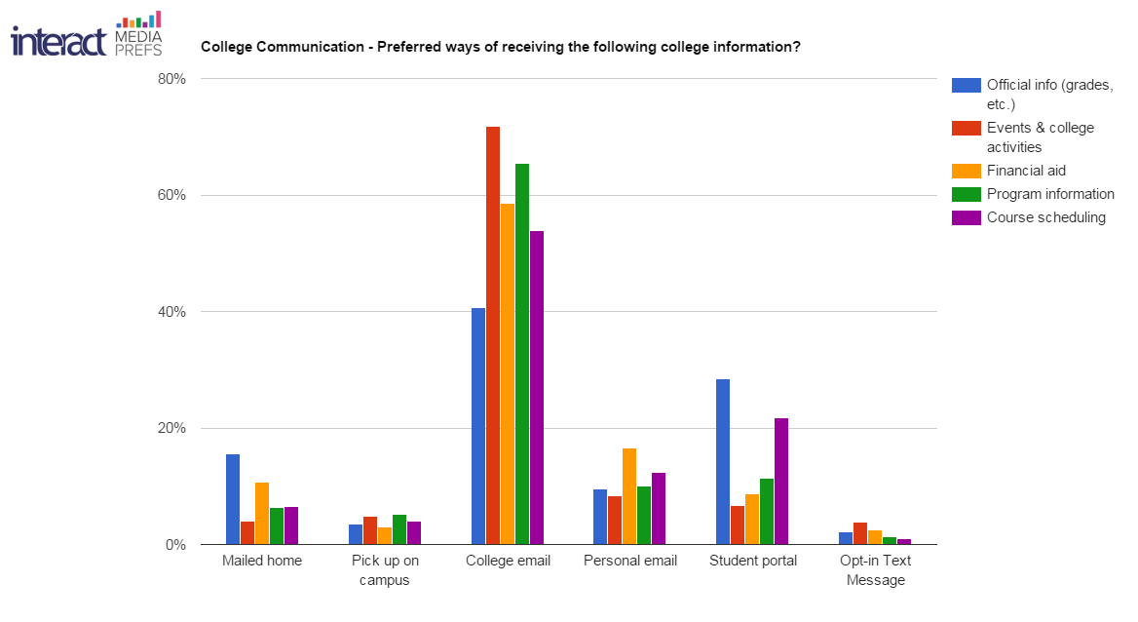

Slide 7
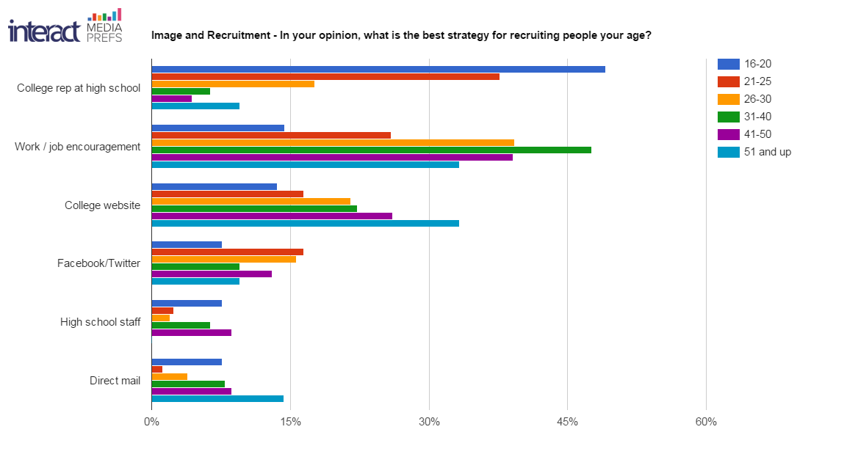

Slide 8
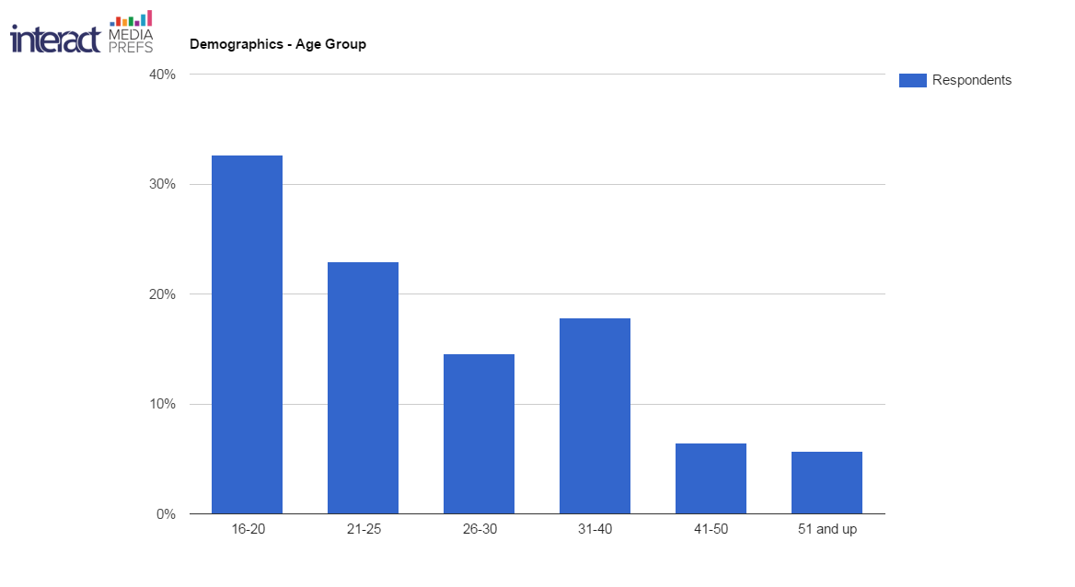
Students 25 and younger accounted for the majority of responses,
which is also true of the overall student body.

Slide 9
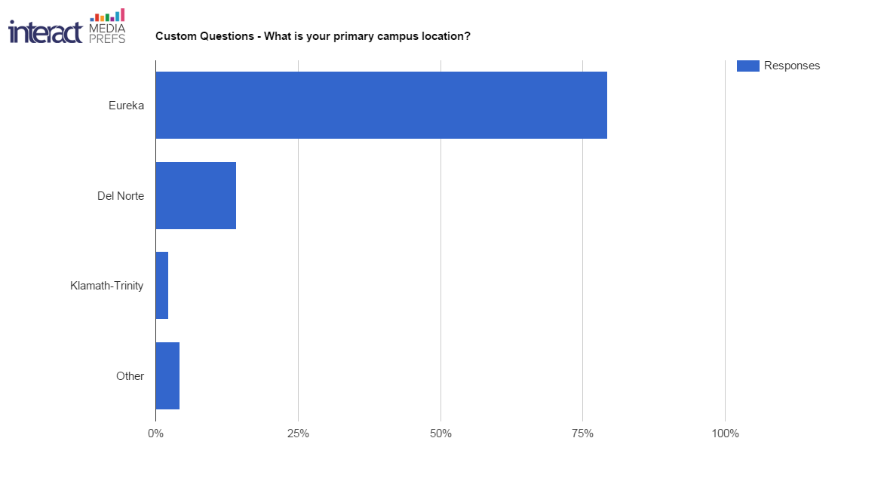
Over 50 students at the Del Norte campus responded (12.5%).
Del Norte students make up almost ten percent of the overall
student body.

